Slide 1
Kepler’s three laws of planetary motion

Slide 2
https://www.youtube.com/watch?v=htxGvdQbl5w

Slide 3
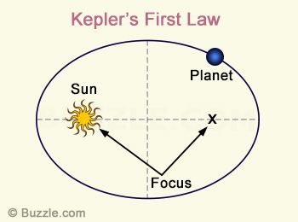
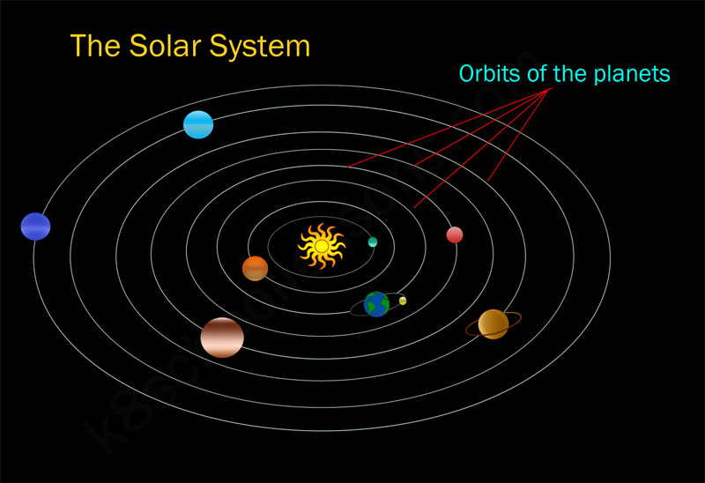
First law- The Law of Ellipses
The orbit of a planet is an ellipse with the Sun at one of the two foci.

Slide 4
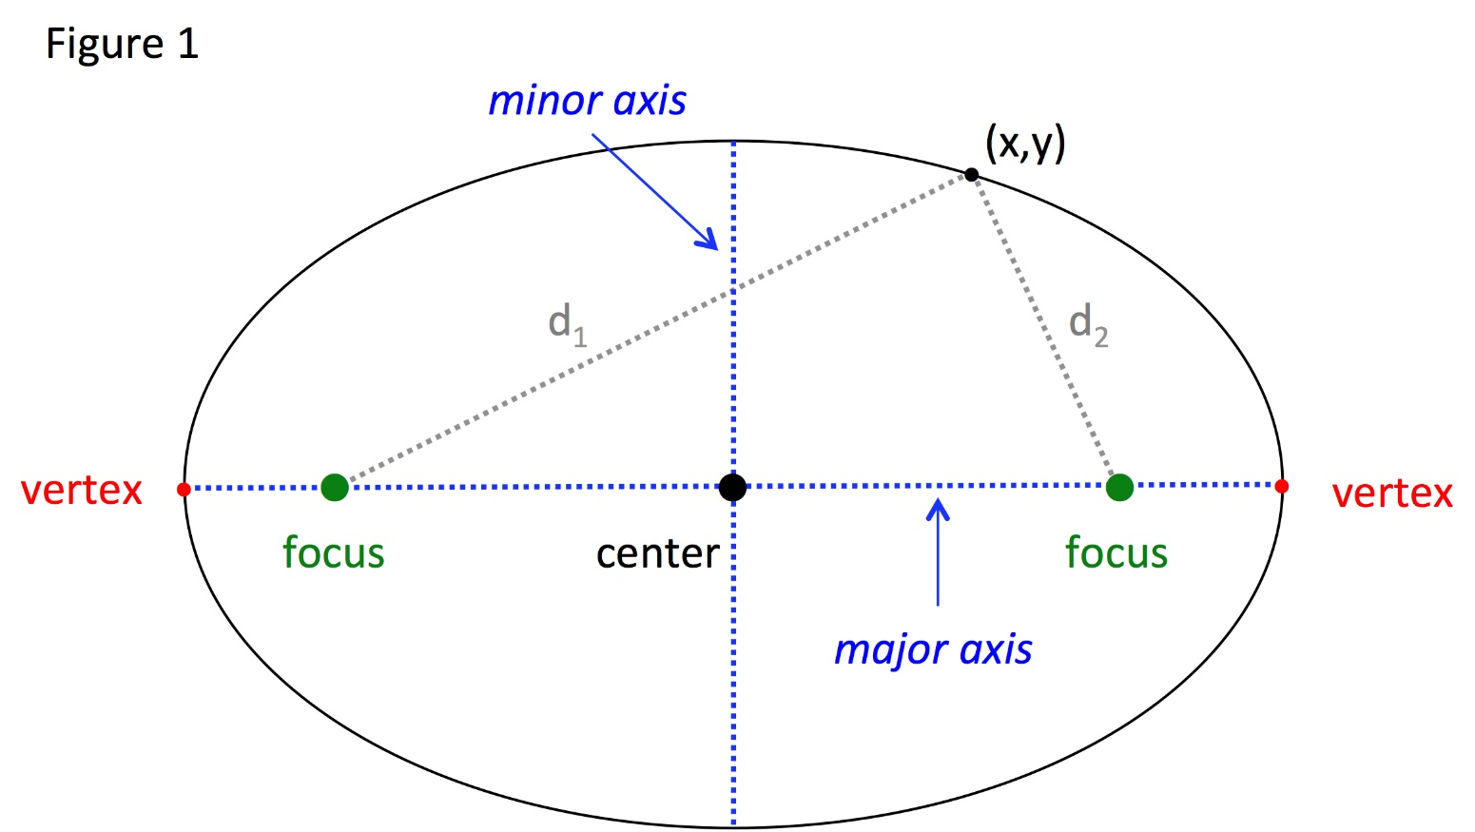
Ellipse
An ellipse is a curve in a plane surrounding two focal points such that the sum of the distances to the two foci is constant for every point on the curve.

Slide 5
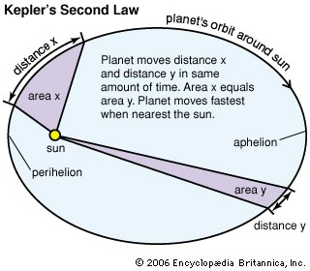
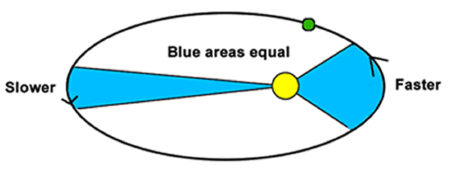
The Second Law- The Law of Equal Areas
A line segment joining a planet and the Sun sweeps out equal areas in equal intervals of time.

Slide 6
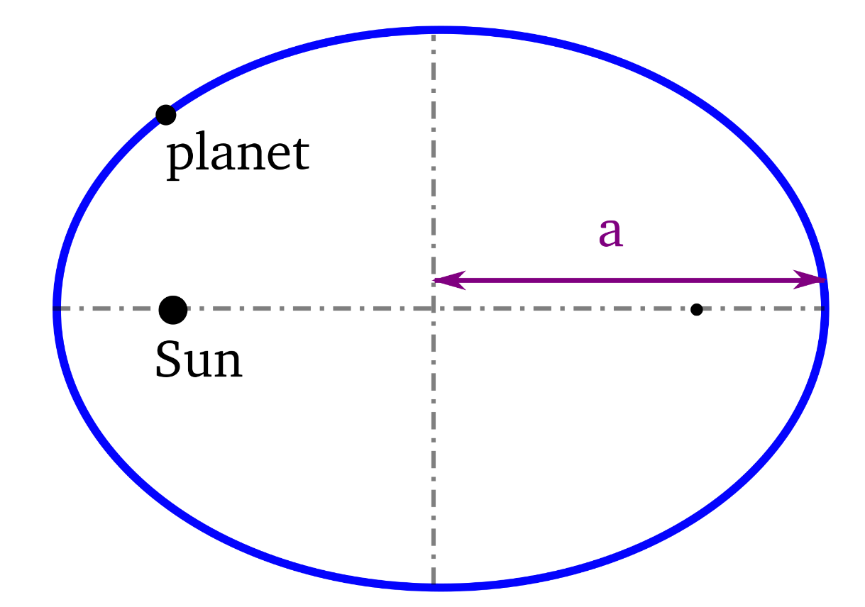
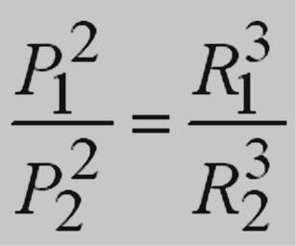
The Third Law- The Law of Harmonies
The ratio of the squares of the periods of any two planets is equal to the ratio of the cubes of the semi-major axis of its orbit. (average distances from the Sun)
Period: How long it takes for a planet to complete one orbit around the Sun

Slide 7
Planet | Period (s) | Average Distance (m) | T²/R³ (s²/m³)
Earth | 3.156 x 10⁷ s | 1.4957 x 10¹¹ | 2.977 x 10⁻¹⁹
Mars | 5.93 x 10⁷ s | 2.278 x 10¹¹ | 2.975 x 10⁻¹⁹

Slide 8

Problem 1.
The average distance of Earth from the Sun is $1.5∙{10}^{8}$ km. The period of the Mars is 1.881 years. Calculate the average distance of Mars from the Sun.
Astronomical unit=the average distance of Earth from the Sun is $1.5∙{10}^{8}$ km.

Slide 9

Problem 2.
The average distance of Mercury from the Sun is $5.785∙{10}^{7}$km. Find the period of the Mercury.

